Slide 1
Insects in space

Slide 2
Introduction
Studies made on insects already done :
Can be eaten
Ants, bees, fruit flies are not changing their behavior

Slide 3
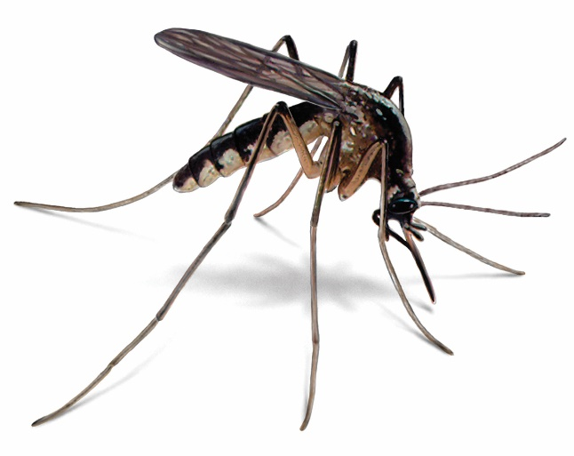


Experiment 1 : effet of space on the mosquitoes’ behavior
Problems :
Are space conditions affecting the mosquitoes behavior ?
Are they still reproducing ?
Does their life-expectancy change in space ?
Orkin
Observation of their behavior

Slide 4



Experiment 2 : effect of space on the mosquitoes’ infectiousity
Problems :
Can space affect the infectiousity of mosquitoes ?
Can space affect the resistance of plants to diseases carried by mosquitoes ?
Can be infected by mosquitos on Earth
vs
Number of plants infected depending on the localisation

Slide 5
Conclusion
Useful to better understand the mosquitoes’ behavior under extreme conditions
Link the results with global changes affecting the Earth

